Slide 1
Simplify the expression using Boolean algebra techniques
AB + A(B+C)+ B(B+C)

Slide 2
Solution : AB + A(B+C)+ B(B+C)
Step 1: Apply distributive law second and third term in the expression AB+AB+AC+BB+BC
Step 2 : Apply the rule no :7 BB=B
AB+AB+AC+B+BC
Step:3 Apply rule no 5 : AB+AB= AB AB+AC+B+BC
Step :4 Apply rule no 10: B+BC=B
AB+AC+B
Step :5 apply rule no 10 :AB+B=B
B+AC

Slide 3


Slide 4
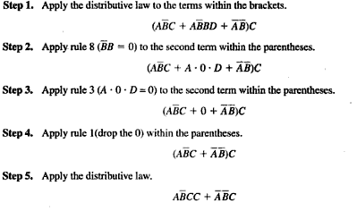
Solution

Slide 5
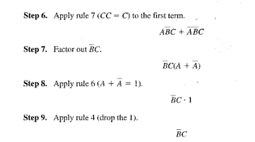

Slide 6


Slide 7
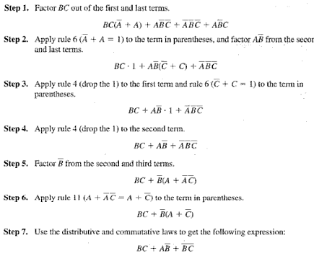
solution

Slide 8


Slide 9
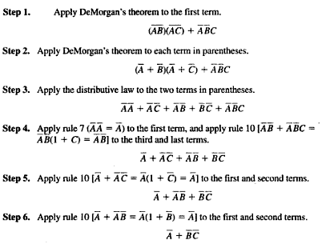
solution

